Slide 1
Input/ Output (I/O) Devices
The method that is used to transfer information between internal storage and external I/O devices is known as I/O interface.
The CPU is interfaced using special communication links by the peripherals connected to any computer system.
These communication links are used to resolve the differences between CPU and peripheral.
There exists special components between CPU and peripherals to supervise and synchronize all the input and output transfers that are called interface units.

Slide 2
Input/ Output (I/O) Devices
Data transfer to and from the peripherals may be done in any of the three possible ways
1. Programmed I/O.
2. Interrupt-driven I/O
3. Direct memory access( DMA).

Slide 3
Input/ Output (I/O) Devices
Programmed I/O
Each data item transfer is initiated by an instruction in the program.
Usually the transfer is from a CPU register and memory. In this case it requires constant monitoring by the CPU of the peripheral devices.
This is a time consuming process since it needlessly keeps the CPU busy. CPU checks the status of I/O in regular basis.

Slide 4
Input/ Output (I/O) Devices
Interrupt driven I/O
It does not require constant monitoring by CPU.
Whenever it is determined that the device is ready for data transfer it initiates an interrupt request signal to the computer.
The processor is interrupted by an interrupt signal and the Interrupt Service Routine (ISR) is executed.

Slide 5
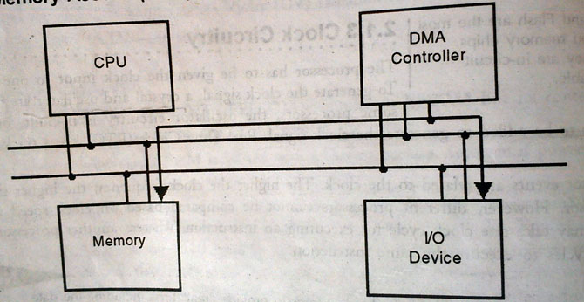
Dynamic Memory Access(DMA)
Generally, Data transfer between I/O device and the memory is coordinated by the CPU.
If in case handling of I/O device by the processor is not sufficient, data transfer between the I/O device and the memory can take place directly, which is known as DMA.
A special device called DMA controller does the job. DMA controller takes the control of the buses and transfers data between the I/O device and the memory.

Slide 6
Light Emitting Diodes (LEDs)
LEDs: Light Emitting Diode (LED) is an important output device for visual indication in any embedded system.
LED can be used as an indicator for the status of various signals or situations.
Typical example are indicating the presence of power conditions like “Device On” and “Battery Low” etc.
Even Red, green and yellow LEDs are used for status display as well as for indications of visual alarms for such events as power supply failure.

Slide 7
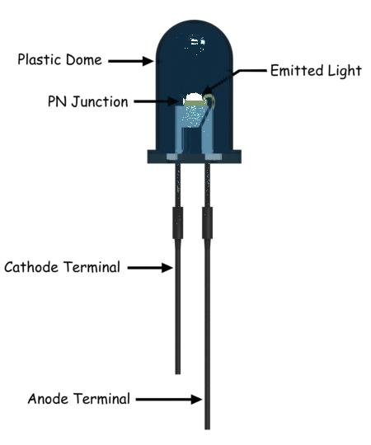

LED

Slide 8
LED
A light emitting diode is an electric component that emits light when the electric current flows through it.
It is a specific type of diode having similar characteristics as the p-n junction diode. Which means that an LED allows the flow of current in its forward direction while it blocks the flow in the reverse direction.
When current passes through the LED, the electrons recombine with holes emitting light in the process.

Slide 9
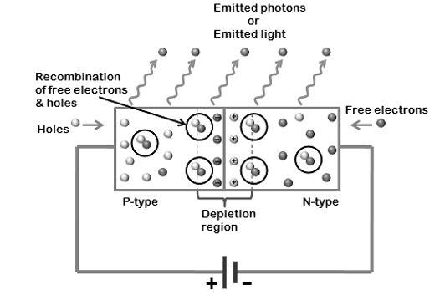
LED
When it is forward biased, depletion layer is narrow down, light or
photons are emitted or radiated in all directions.

Slide 10
LED
Advantages
Very low voltage and current are enough to drive the LED. Total power output will be less than 150 milliwatts.
The response time is very less – only about 10 nanoseconds.
Miniature in size and hence lightweight.
Have a rugged construction and hence can withstand shock and vibrations.
An LED has a lifespan of more than 20 years.

Slide 11
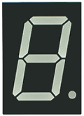
7 segment Display
The 7-segment display, also written as “seven segment display”, consists of seven LEDs arranged in a rectangular fashion.
Each of the seven LEDs is called a segment because when illuminated the segment forms part of a numerical digit (both Decimal and Hex) to be displayed.
An additional 8th LED is sometimes used within the same package thus allowing the indication of a decimal point, (DP).

Slide 12
7 segment Display
Each one of the seven LEDs in the display is given a positional segment with one of its connection pins being brought straight out of the rectangular plastic package.
These individually LED pins are labelled from a through to g representing each individual LED. The other LED pins are connected together and wired to form a common pin.

Slide 13
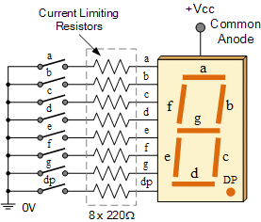
7 segment Display

Slide 14
7 segment Display
There are two types of LED 7-segment display called: Common Cathode (CC) and Common Anode (CA).

Slide 15
7 segment Display
Common Cathode
In the common cathode display, all the cathode connections of the LED segments are joined together to logic “0” or ground. The individual segments are illuminated by application of a “HIGH”, or logic “1” signal via a current limiting resistor to forward bias the individual Anode terminals (a-g).

Slide 16
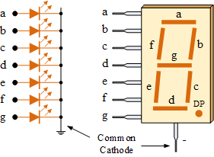
7 segment Display

Slide 17
7 segment Display
Common Anode
In the common anode display, all the anode connections of the LED segments are joined together to logic “1”. The individual segments are illuminated by applying a ground, logic “0” or “LOW” signal via a suitable current limiting resistor to the Cathode of the particular segment (a-g).

Slide 18
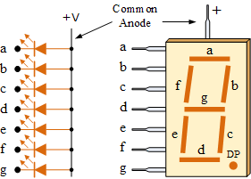
7 segment Display

Slide 19

7 segment Display

Slide 20
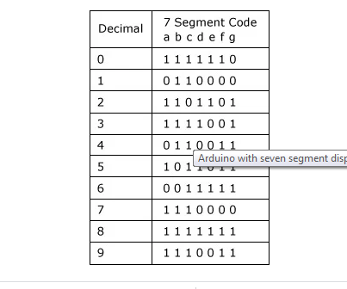
7 segment Display

Slide 21
7 segment Display
CA

Slide 22
Liquid Crystal Display (LCD)
Liquid crystal displays (LCDs) is used to display the status information or to display prompts to the user.
Liquid-crystal display has the distinct advantage of having a low power consumption.
An LCD is an electronic display module which uses liquid crystal to produce a visible image.

Slide 23
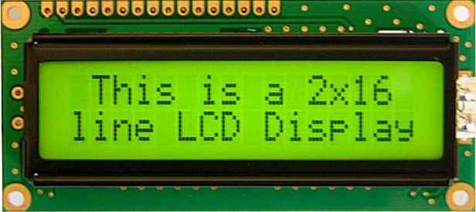
Liquid Crystal Display (LCD)

Slide 24
Display technology is changing very fast. Thin Film Transistor (TFT) displays provide very high resolution display which is used in mobile phones.
Another innovation is 3-dimensional displays in which two LCDs are used to give the 3-dimensional effect.
An OLED (organic light-emitting diode) is a light-emitting diode (LED) in which organic light emitting polymer is placed between anode and cathode.
When a voltage is applied between anode and cathode, the organic material glows. OLED gives a much brighter display as compared to LCD and is now being used on mobile phones.

Slide 25
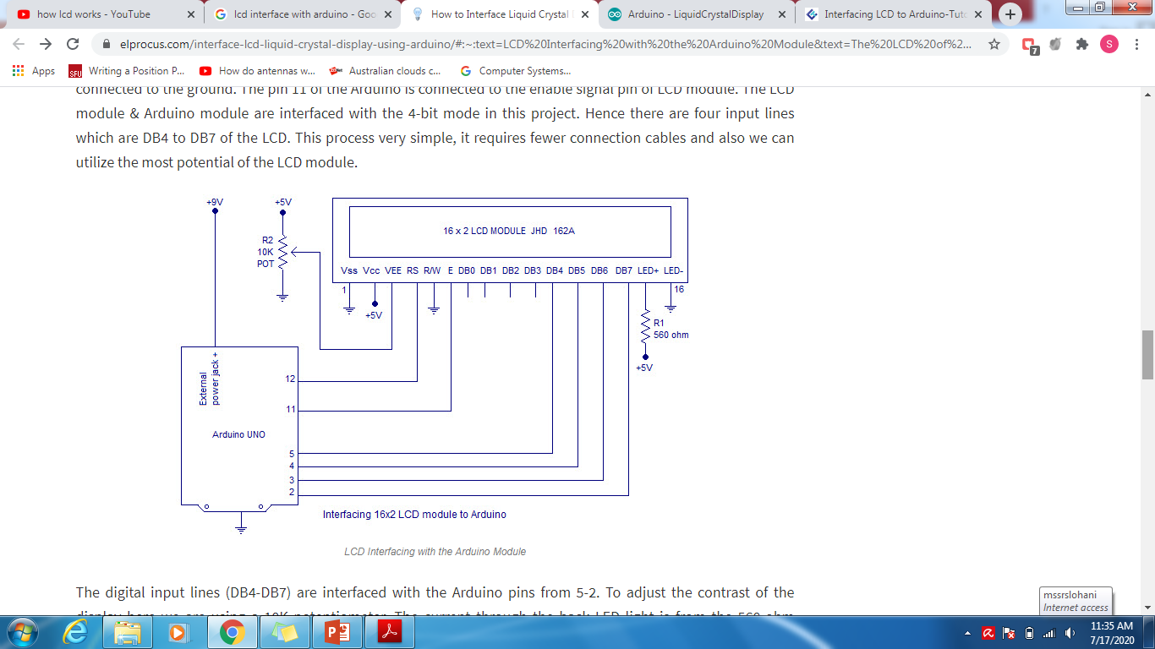
LCD Interfacing with Arduino

Slide 26
Pin No | Pin Name | Pin Description
Pin 1 | GND | This pin is a ground pin and the LCD is connected to the Ground
Pin 2 | VCC | The VCC pin is used to supply the power to the LCD
Pin 3 | VEE | This pin is used for adjusting the contrast of the LCD by connecting the variable resistor in between the VCC & Ground.
Pin 4 | RS | The RS is known as register select and it selects the Command/Data register. To select the command register the RS should be equal to zero. To select the Data register the RS should be equal to one.

Slide 27
Pin 5 | R/W | This pin is used to select the operations of Read/Write. To perform the write operations the R/W should be equal to zero. To perform the read operations the R/W should be equal to one.
Pin 6 | EN | This is a enable signal pin if the positive pulses are passing through a pin, then the pin function as a read/write pin.
Pin 7 | DB0 to DB7 | The pin 7 contains total 8 pins which are used as a Data pin of LCD.
Pin 15 | LED + | This pin is connected to VCC and it is used for the pin 16 to set up the glow of backlight of LCD.
Pin 16 | LED – | This pin is connected to Ground and it is used for the pin 15 to set up the glow of backlight of the LCD.

Slide 28
From the circuit diagram, we can observe that the RS pin of the LCD is connected to the pin 12 of the Arduino.
The LCD of R/W pin is connected to the ground.
The pin 11 of the Arduino is connected to the enable signal pin of LCD module.
The LCD module & Arduino module are interfaced with the 4-bit mode in this project. Hence there are four input lines which are DB4 to DB7 of the LCD. This process very simple, it requires fewer connection cables and also we can utilize the most potential of the LCD module.

Slide 29
The digital input lines (DB4-DB7) are interfaced with the Arduino pins from 5-2. To adjust the contrast of the display here we are using a 10K potentiometer. The current through the back LED light is from the 560-ohm resistor. The external power jack is provided by the board to the Arduino.

